Slide 1


Exposure Java 2013
APCS Edition
Chapter 6 Slides
Using Object Methods
PowerPoint Presentation
created by:
Mr. John L. M. Schram
and Mr. Leon Schram
Authors of Exposure Java

Slide 2
Section 6.2
Classes &
Objects

Slide 3
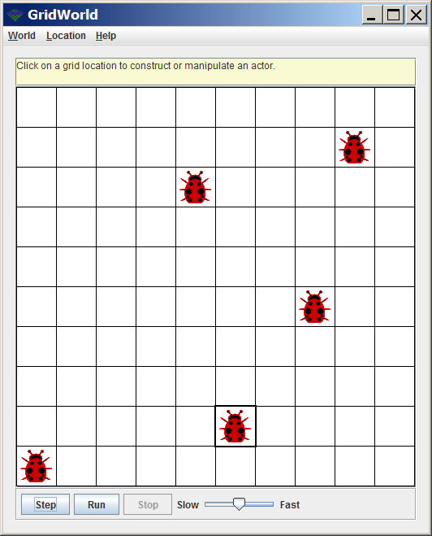
Visual Classes
1 Class:
Bug
5 Objects:
All Bug Objects

Slide 4
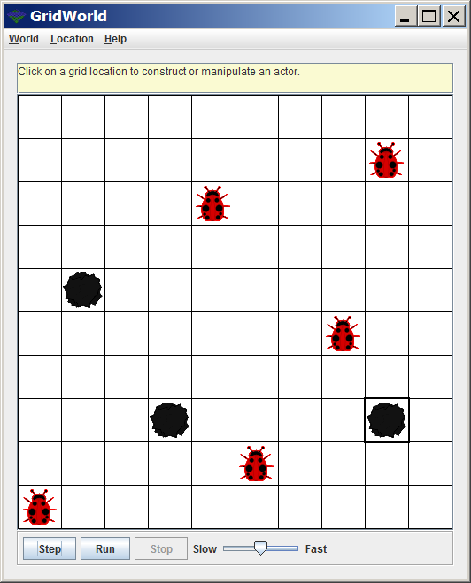
Visual Classes
2 Classes:
Bug
Rock
8 Objects:
5 Bug Objects
3 Rock Objects

Slide 5
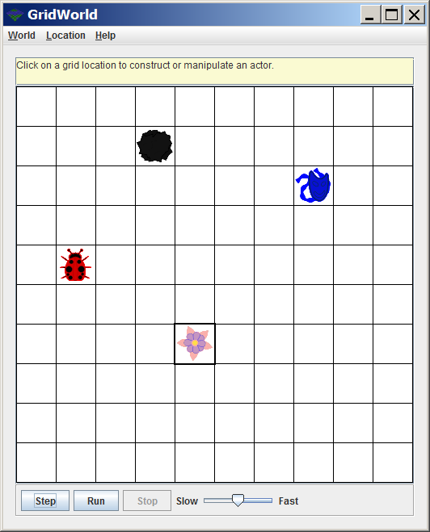
Visual Classes
4 Classes:
Bug
Flower
Rock
Actor
4 Objects:
1 Bug Object
1 Flower Object
1 Rock Object
1 Actor Object

Slide 6
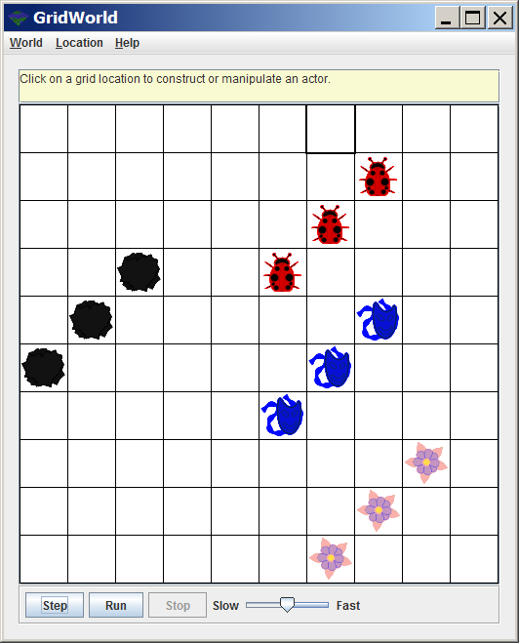
Visual Classes
4 Classes:
Bug
Flower
Rock
Actor
12 Objects:
3 Bug Objects
3 Flower Objects
3 Rock Objects
3 Actor Objects

Slide 7
Classes and Objects
A class is a category.
An object is one example of a category.
You can have more objects than classes.
You can never have more classes than objects.
By Java convention all class identifiers start with upper-case and all object identifiers start with lower-case.

Slide 8
Review of Math Class Methods
abs
sqrt
max
min
round
pow
ceil
floor

Slide 9


Review of Math Class Attributes
PI
E
 | Circumference of a Circle / its Diameter
 | About 3.1415926535897932384626433832795
 | Base of the Natural Log
 | About 2.7182818284590452353602874713526

Slide 10
Section 6.3
Using Object
Methods

Slide 11
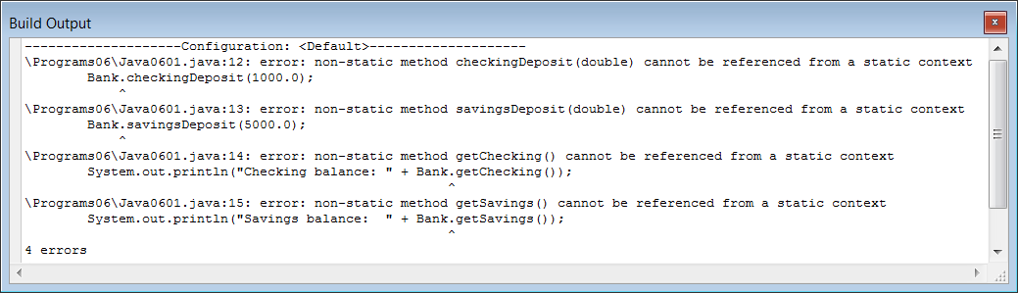
// Java0601.java
// This program demonstrates that the methods of a class are not always
// accessible, like they were with the <Math> class. In this case an
// attempt is made to use methods of the <Bank> class without success.
public class Java0601
{
public static void main (String args[])
{
System.out.println("\nJAVA0601.JAVA\n");
Bank.checkingDeposit(1000.0);
Bank.savingsDeposit(5000.0);
System.out.println("Checking balance: " + Bank.getChecking());
System.out.println("Savings balance: " + Bank.getSavings());
System.out.println();
}
}

Slide 12
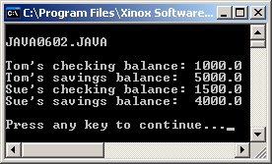
// Java0602.java
// This program creates two Bank objects, called tom and sue.
// Each object stores its own Bank information.
public class Java0602
{
public static void main (String args[])
{
System.out.println("\nJAVA0602.JAVA\n");
Bank tom;
tom = new Bank();
Bank sue;
sue = new Bank();
tom.checkingDeposit(1000.0);
tom.savingsDeposit(5000.0);
sue.checkingDeposit(1500.0);
sue.savingsDeposit (4000.0);
System.out.println("Tom's checking balance: " + tom.getChecking());
System.out.println("Tom's savings balance: " + tom.getSavings());
System.out.println("Sue's checking balance: " + sue.getChecking());
System.out.println("Sue's savings balance: " + sue.getSavings());
System.out.println();
}
}

Slide 13
Data Types & Variables vs. Classes & Objects
You have seen program statements like:
In this case, int is the data type and x is the variable.
The previous program had this statement:
In this case, Bank is the data type and tom is the variable ; however, Bank is a special data type called a class, and tom is a special variable called an object.
int x;
Bank tom;

Slide 14
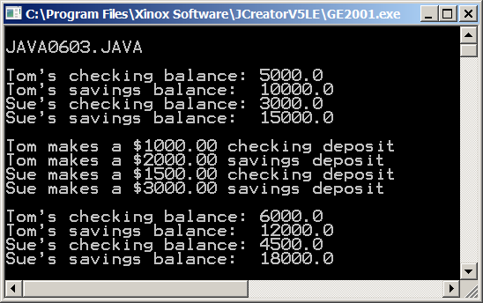
// Java0603.java
// This program demonstrates how an object can be constructed with a specified initial balance in checking
// and savings. Most Java classes have multiple constructors to create objects for multiple situations.
public class Java0603
{
public static void main (String args[])
{
System.out.println("\nJAVA0603.JAVA\n");
Bank tom;
tom = new Bank(5000.0,10000.0);
Bank sue;
sue = new Bank(3000.0,15000.0);
System.out.println("Tom's checking balance: " + tom.getChecking());
System.out.println("Tom's savings balance: " + tom.getSavings());
System.out.println("Sue's checking balance: " + sue.getChecking());
System.out.println("Sue's savings balance: " + sue.getSavings());
System.out.println();
System.out.println("Tom makes a $1000.00 checking deposit");
tom.checkingDeposit(1000.0);
System.out.println("Tom makes a $2000.00 savings deposit");
tom.savingsDeposit(2000.0);
System.out.println("Sue makes a $1500.00 checking deposit");
sue.checkingDeposit(1500.0);
System.out.println("Sue makes a $3000.00 savings deposit");
sue.savingsDeposit(3000.0);
System.out.println();
System.out.println("Tom's checking balance: " + tom.getChecking());
System.out.println("Tom's savings balance: " + tom.getSavings());
System.out.println("Sue's checking balance: " + sue.getChecking());
System.out.println("Sue's savings balance: " + sue.getSavings());
System.out.println();
}
}

Slide 15
The Preferred Way
Let us think back to Chapter 3.
You were shown statements that
define and initialize variables like:
But then, you were shown that it is
better to define and initialize your
variables in one statement like this:
The same thing applies to creating objects.
The previous program first declared an object,
and then constructed it, with 2 separate statements:
As before, it is better to combine these 2 statements into one.
We can declare and construct the object in one statement like this:
int x;
x = 5;
int x = 5;
Bank tom;
tom = new Bank(5000.0,10000.0);
Bank tom = new Bank(5000.0,10000.0);

Slide 16
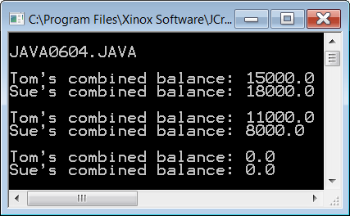
// Java0604.java
// This program demonstrates how an object can be declared and defined all in one statement.
// It also demonstrates the <checkingWithdrawal> & <savingsWithdrawal> methods of the <Bank> class
// It also demonstrates other <Bank> class methods like <getCombined>.
// This method returns the combined checking and savings balance.
// It also shows how to close bank accounts with the <closeChecking> and the <closeSavings> methods.
public class Java0604
{
public static void main (String args[])
{
System.out.println("\nJAVA0604.JAVA\n");
Bank tom = new Bank(5000.0,10000.0);
Bank sue = new Bank(3000.0,15000.0);
System.out.println("Tom's combined balance: " + tom.getCombined());
System.out.println("Sue's combined balance: " + sue.getCombined());
System.out.println();
tom.checkingWithdrawal(4000);
sue.savingsWithdrawal(10000);
System.out.println("Tom's combined balance: " + tom.getCombined());
System.out.println("Sue's combined balance: " + sue.getCombined());
System.out.println();
tom.closeChecking();
tom.closeSavings();
sue.closeChecking();
sue.closeSavings();
System.out.println("Tom's combined balance: " + tom.getCombined());
System.out.println("Sue's combined balance: " + sue.getCombined());
System.out.println();
}
}

Slide 17
Section 6.4
Using the
Random
class

Slide 18
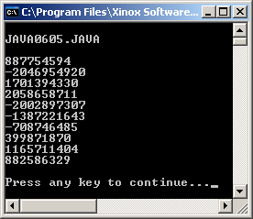
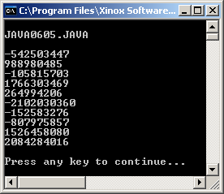
// Java0605.java
// This program introduces the <Random> class, which is part of the <java.util>
// package. The <nextInt> method returns a random integer value. Note that the
// values change each time that you execute the program.
import java.util.Random;
public class Java0605
{
public static void main (String args[])
{
System.out.println("\nJAVA0605.JAVA\n");
Random rand = new Random();
System.out.println(rand.nextInt());
System.out.println(rand.nextInt());
System.out.println(rand.nextInt());
System.out.println(rand.nextInt());
System.out.println(rand.nextInt());
System.out.println(rand.nextInt());
System.out.println(rand.nextInt());
System.out.println(rand.nextInt());
System.out.println(rand.nextInt());
System.out.println(rand.nextInt());
System.out.println();
}
}

Slide 19
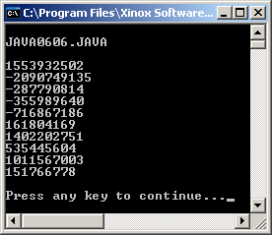
// Java0606.java
// This program "seeds" the Random object with a specific starting seed.
// Multiple executions will now display the same random numbers.
import java.util.Random;
public class Java0606
{
public static void main (String args[])
{
System.out.println("\nJAVA0606.JAVA\n");
Random rand = new Random(12345);
System.out.println(rand.nextInt());
System.out.println(rand.nextInt());
System.out.println(rand.nextInt());
System.out.println(rand.nextInt());
System.out.println(rand.nextInt());
System.out.println(rand.nextInt());
System.out.println(rand.nextInt());
System.out.println(rand.nextInt());
System.out.println(rand.nextInt());
System.out.println(rand.nextInt());
System.out.println();
}
}

Slide 20
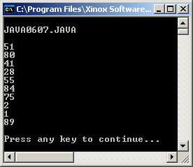
// Java0607.java
// This program demonstrates the second "overloaded" <nextInt(n)> method,
// which returns an integer x, such that 0 <= x < n.
import java.util.Random;
public class Java0607
{
public static void main (String args[])
{
System.out.println("\nJAVA0607.JAVA\n");
Random rand = new Random(12345);
System.out.println(rand.nextInt(100));
System.out.println(rand.nextInt(100));
System.out.println(rand.nextInt(100));
System.out.println(rand.nextInt(100));
System.out.println(rand.nextInt(100));
System.out.println(rand.nextInt(100));
System.out.println(rand.nextInt(100));
System.out.println(rand.nextInt(100));
System.out.println(rand.nextInt(100));
System.out.println(rand.nextInt(100));
System.out.println();
}
}

Slide 21
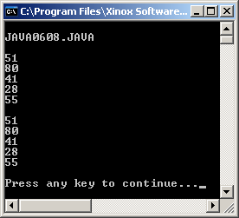
// Java0608.java
// This program introduces the <setSeed> method. This method allows you to
// control the "randomness" and repeat the same sequence.
import java.util.Random;
public class Java0608
{
public static void main (String args[])
{
System.out.println("\nJAVA0608.JAVA\n");
Random rand = new Random(12345);
System.out.println(rand.nextInt(100));
System.out.println(rand.nextInt(100));
System.out.println(rand.nextInt(100));
System.out.println(rand.nextInt(100));
System.out.println(rand.nextInt(100));
System.out.println();
rand.setSeed(12345);
System.out.println(rand.nextInt(100));
System.out.println(rand.nextInt(100));
System.out.println(rand.nextInt(100));
System.out.println(rand.nextInt(100));
System.out.println(rand.nextInt(100));
System.out.println();
}
}

Slide 22
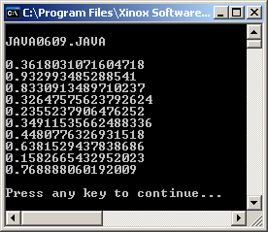
// Java0609.java
// This program demonstrates the <nextDouble> method,
// which returns a real x, such that 0 <= x < 1.
import java.util.Random;
public class Java0609
{
public static void main (String args[])
{
System.out.println("\nJAVA0609.JAVA\n");
Random rand = new Random(12345);
System.out.println(rand.nextDouble());
System.out.println(rand.nextDouble());
System.out.println(rand.nextDouble());
System.out.println(rand.nextDouble());
System.out.println(rand.nextDouble());
System.out.println(rand.nextDouble());
System.out.println(rand.nextDouble());
System.out.println(rand.nextDouble());
System.out.println(rand.nextDouble());
System.out.println(rand.nextDouble());
System.out.println();
}
}

Slide 23
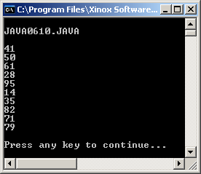
// Java0610.java
// This program demonstrates how to control an Random class object so that it
// generates integers in a desired range. In this example the range is [10..99].
import java.util.Random;
public class Java0610
{
public static void main (String args[])
{
System.out.println("\nJAVA0610.JAVA\n");
Random rand = new Random(12345);
System.out.println(rand.nextInt(90) + 10);
System.out.println(rand.nextInt(90) + 10);
System.out.println(rand.nextInt(90) + 10);
System.out.println(rand.nextInt(90) + 10);
System.out.println(rand.nextInt(90) + 10);
System.out.println(rand.nextInt(90) + 10);
System.out.println(rand.nextInt(90) + 10);
System.out.println(rand.nextInt(90) + 10);
System.out.println(rand.nextInt(90) + 10);
System.out.println(rand.nextInt(90) + 10);
System.out.println();
}
}

Slide 24
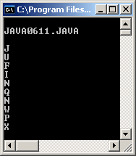
// Java0611.java
// This program demonstrates how to control an Random class object so that it
// generates random upper-case letters. Note how "type casting" with (char) is
// used to change random integers in the [65..90] range to [A..Z] letters.
import java.util.Random;
public class Java0611
{
public static void main (String args[])
{
System.out.println("\nJAVA0611.JAVA\n");
Random rand = new Random(12345);
System.out.println( (char) (rand.nextInt(26) + 65) );
System.out.println( (char) (rand.nextInt(26) + 65) );
System.out.println( (char) (rand.nextInt(26) + 65) );
System.out.println( (char) (rand.nextInt(26) + 65) );
System.out.println( (char) (rand.nextInt(26) + 65) );
System.out.println( (char) (rand.nextInt(26) + 65) );
System.out.println( (char) (rand.nextInt(26) + 65) );
System.out.println( (char) (rand.nextInt(26) + 65) );
System.out.println( (char) (rand.nextInt(26) + 65) );
System.out.println( (char) (rand.nextInt(26) + 65) );
System.out.println();
}
}

Slide 25
Random Numbers Review
Random numbers are used in many areas of life:
Video Games
Simulations
The Lottery
Usually you need a random integer in a specified range.
large = Largest integer you want
small = Smallest integer you want
range = large - small + 1
System.out.println(rand.nextInt(range) + small);

Slide 26
AP Exam Alert
The Random class, and its methods, are not tested on the AP Exam.
However, the random method of the Math class will be tested.

Slide 27
Section 6.5
Using the
Math.Random
Method

Slide 28
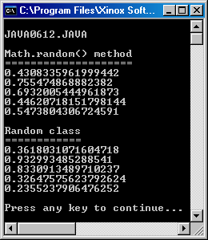
// Java0612.java
// This program demonstrates the Math.random method.
// Notice that it behaves just like the nextDouble method of the Random class.
// Both will return a random real number n such that 0 <= n < 1
import java.util.Random; // needed for Random class, but not needed for Math.random method
public class Java0612
{
public static void main (String args[])
{
System.out.println("\nJAVA0612.JAVA\n");
System.out.println("Math.random() method");
System.out.println("====================");
System.out.println(Math.random());
System.out.println(Math.random());
System.out.println(Math.random());
System.out.println(Math.random());
System.out.println(Math.random());
System.out.println();
System.out.println("Random class");
System.out.println("============");
Random rand = new Random(12345);
System.out.println(rand.nextDouble());
System.out.println(rand.nextDouble());
System.out.println(rand.nextDouble());
System.out.println(rand.nextDouble());
System.out.println(rand.nextDouble());
System.out.println();
}
}

Slide 29
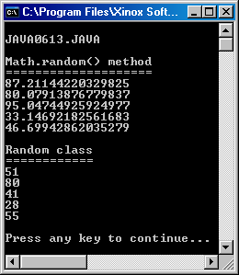
// Java0613.java
// This program demonstrates the Math.random method being used to display
// random real numbers in the range of 0 to 99.
// Note the comparisson with the nextInt method of the Random class.
import java.util.Random;
public class Java0613
{
public static void main (String args[])
{
System.out.println("\nJAVA0613.JAVA\n");
System.out.println("Math.random() method");
System.out.println("====================");
System.out.println(Math.random() * 100);
System.out.println(Math.random() * 100);
System.out.println(Math.random() * 100);
System.out.println(Math.random() * 100);
System.out.println(Math.random() * 100);
System.out.println();
System.out.println("Random class");
System.out.println("============");
Random rand = new Random(12345);
System.out.println(rand.nextInt(100));
System.out.println(rand.nextInt(100));
System.out.println(rand.nextInt(100));
System.out.println(rand.nextInt(100));
System.out.println(rand.nextInt(100));
System.out.println();
}
}

Slide 30
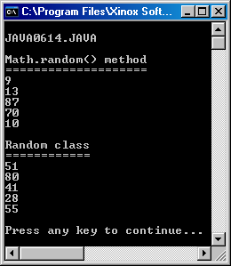
// Java0614.java
// This program demonstrates the Math.random method being used to display
// random integers in the range of 0 to 99 by using typecasting.
// Note the comparison with the nextInt method of the Random class.
import java.util.Random;
public class Java0614
{
public static void main (String args[])
{
System.out.println("\nJAVA0614.JAVA\n");
System.out.println("Math.random() method");
System.out.println("====================");
System.out.println( (int) (Math.random() * 100) );
System.out.println( (int) (Math.random() * 100) );
System.out.println( (int) (Math.random() * 100) );
System.out.println( (int) (Math.random() * 100) );
System.out.println( (int) (Math.random() * 100) );
System.out.println();
System.out.println("Random class");
System.out.println("============");
Random rand = new Random(12345);
System.out.println(rand.nextInt(100));
System.out.println(rand.nextInt(100));
System.out.println(rand.nextInt(100));
System.out.println(rand.nextInt(100));
System.out.println(rand.nextInt(100));
System.out.println();
}
}

Slide 31
n * Math.random Ranges
n = ? | Math.random returns smallest value of 0.0 | Math.random returns largest of 0.999999...
20 | 20 * 0.0 = 0 | 20 * 0.99999... = 19.99999...
50 | 50 * 0.0 = 0 | 50 * 0.99999... = 49.99999...
100 | 100 * 0.0 = 0 | 100 * 0.99999... = 99.99999...

Slide 32
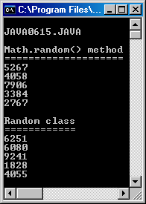
// Java0615.java
// This program demonstrates the Math.random method being used to display
// random integers in the range of 1000 to 9999 by using typecasting.
// Note the comparison with the nextInt method of the Random class.
import java.util.Random;
public class Java0615
{
public static void main (String args[])
{
System.out.println("\nJAVA0615.JAVA\n");
System.out.println("Math.random() method");
System.out.println("====================");
System.out.println( (int) (Math.random() * 9000) + 1000);
System.out.println( (int) (Math.random() * 9000) + 1000);
System.out.println( (int) (Math.random() * 9000) + 1000);
System.out.println( (int) (Math.random() * 9000) + 1000);
System.out.println( (int) (Math.random() * 9000) + 1000);
System.out.println();
System.out.println("Random class");
System.out.println("============");
Random rand = new Random(12345);
System.out.println(rand.nextInt(9000) + 1000);
System.out.println(rand.nextInt(9000) + 1000);
System.out.println(rand.nextInt(9000) + 1000);
System.out.println(rand.nextInt(9000) + 1000);
System.out.println(rand.nextInt(9000) + 1000);
System.out.println();
}
}

Slide 33
Math.random Review
Random numbers can also be created with the random method of the Math class in this way:
As before, you start with these 3 values:
large = Largest integer you want
small = Smallest integer you want
range = large - small + 1
int x = (int) (Math.random() * range + small);
What actually happens is that Math.random() returns a real# between 0 and .99999999999... When multiplied by the range it returns a number between 0 and range-1 (similar to nextInt).

Slide 34
Section 6.6
Using the
DecimalFormat
class

Slide 35
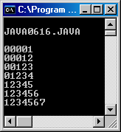
// Java0616.java
// This program demonstrates how to "right justify" integers with an object
// of the <DecimalFormat> class and the <format> method.
import java.text.DecimalFormat;
public class Java0616
{
public static void main (String args[])
{
System.out.println("\nJAVA0616.JAVA\n");
DecimalFormat output = new DecimalFormat("00000");
System.out.println(output.format(1));
System.out.println(output.format(12));
System.out.println(output.format(123));
System.out.println(output.format(1234));
System.out.println(output.format(12345));
System.out.println(output.format(123456));
System.out.println(output.format(1234567));
System.out.println();
}
}
NOTE: The
output.format
is ignored
for numbers
that are
too large.

Slide 36
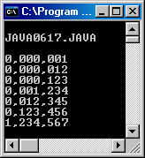
// Java0617.java
// This program demonstrates how to insert commas in numerical output
// with a <DecimalFormat> object.
import java.text.DecimalFormat;
public class Java0617
{
public static void main (String args[])
{
System.out.println("\nJAVA0617.JAVA\n");
DecimalFormat output = new DecimalFormat("0,000,000");
System.out.println(output.format(1));
System.out.println(output.format(12));
System.out.println(output.format(123));
System.out.println(output.format(1234));
System.out.println(output.format(12345));
System.out.println(output.format(123456));
System.out.println(output.format(1234567));
System.out.println();
}
}
Try this!
Change the DecimalFormat to “0,000” and make the last number 1234567890

Slide 37
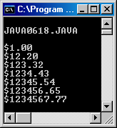
// Java0618.java
// This program demonstrates how to display US currency amounts.
// Additionally, note how the <format> methods rounds off to the nearest penny.
import java.text.DecimalFormat;
public class Java0618
{
public static void main (String args[])
{
System.out.println("\nJAVA0618.JAVA\n");
DecimalFormat money = new DecimalFormat("$0.00");
System.out.println(money .format(1));
System.out.println(money .format(12.2));
System.out.println(money .format(123.32));
System.out.println(money .format(1234.432));
System.out.println(money .format(12345.543));
System.out.println(money .format(123456.654));
System.out.println(money .format(1234567.765));
System.out.println();
}
}

Slide 38
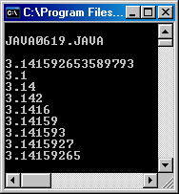
// Java0619.java
// This program demonstrates how to control rounding off to a specified
// number of digits beyond the decimal point.
import java.text.DecimalFormat;
public class Java0619
{
public static void main (String args[])
{
System.out.println("\nJAVA0619.JAVA\n");
DecimalFormat output1 = new DecimalFormat("0.0");
DecimalFormat output2 = new DecimalFormat("0.00");
DecimalFormat output3 = new DecimalFormat("0.000");
DecimalFormat output4 = new DecimalFormat("0.0000");
DecimalFormat output5 = new DecimalFormat("0.00000");
DecimalFormat output6 = new DecimalFormat("0.000000");
DecimalFormat output7 = new DecimalFormat("0.0000000");
DecimalFormat output8 = new DecimalFormat("0.00000000");
System.out.println(Math.PI);
System.out.println(output1.format(Math.PI));
System.out.println(output2.format(Math.PI));
System.out.println(output3.format(Math.PI));
System.out.println(output4.format(Math.PI));
System.out.println(output5.format(Math.PI));
System.out.println(output6.format(Math.PI));
System.out.println(output7.format(Math.PI));
System.out.println(output8.format(Math.PI)); System.out.println();
}
}

Slide 39
Section 6.7
Working with
Graphics
Objects

Slide 40
// Java0620.java
// This program shows how you can create your own display colors by
// creating color objects with different (Red, Green, Blue) values.
// RGB values are in the [0..255] range.
import java.awt.*;
import java.applet.*;
public class Java0620 extends Applet
{
public void paint(Graphics g)
{
g.setColor(new Color(255,0,255));
g.fillRect(0,0,800,200);
g.setColor(new Color(0,255,255));
g.fillRect(0,200,800,200);
g.setColor(new Color(100,100,100));
g.fillRect(0,400,800,200);
}
}
Output on the
next slide.

Slide 41
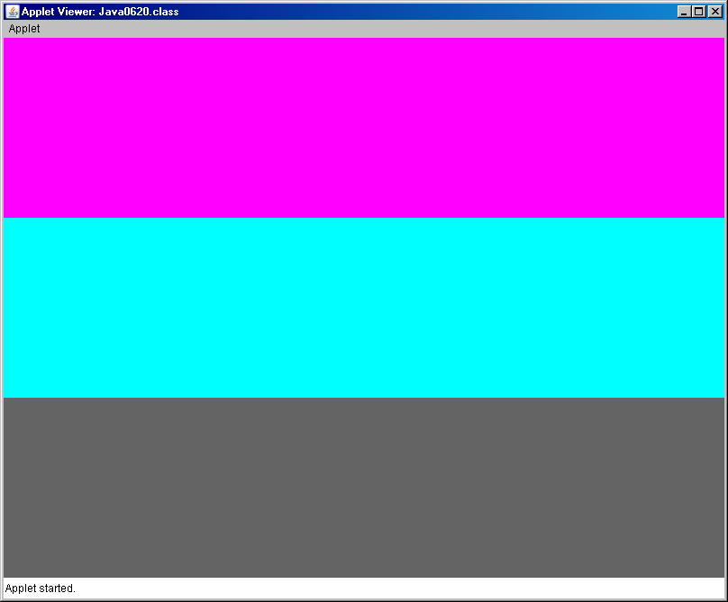

Slide 42
// Java0621.java
// This program shows all the shades of Red, Green and Blue using the <setColor> method.
import java.awt.*;
import java.applet.*;
public class Java0621 extends Applet
{
public void paint(Graphics g)
{
for (int red = 0; red <= 255; red++)
{
g.setColor(new Color(red,0,0));
g.drawLine(red,0,red,600);
}
for (int green = 0; green <= 255; green++)
{
g.setColor(new Color(0,green,0));
g.drawLine(green+255,0,green+255,600);
}
for (int blue = 0; blue <= 255;blue++)
{
g.setColor(new Color(0,0,blue));
g.drawLine(blue+510,0,blue+510,600);
}
}
}
Output on the
next slide.

Slide 43
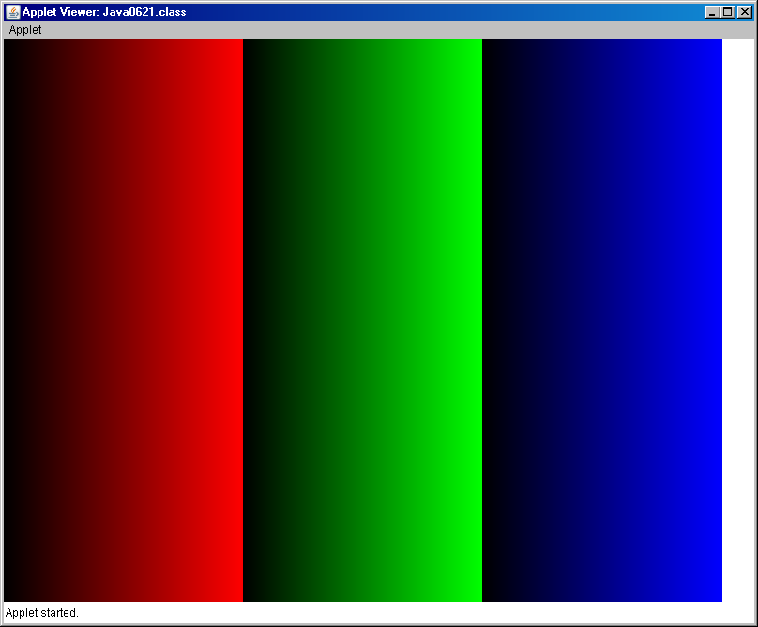

Slide 44
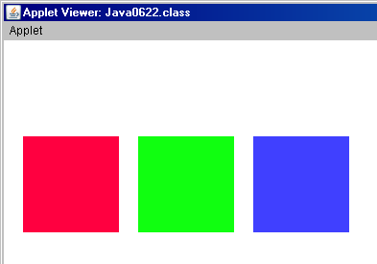
// Java0622.java
// This program draws three squares with user-defined <Color> objects.
import java.awt.*;
import java.applet.*;
public class Java0622 extends Applet
{
public void paint(Graphics g)
{
Color myRed = new Color(255,0,64);
Color myGreen = new Color(16,255,16);
Color myBlue = new Color(64,64,255);
g.setColor(myRed);
g.fillRect(20,100,100,100);
g.setColor(myGreen);
g.fillRect(140,100,100,100);
g.setColor(myBlue);
g.fillRect(260,100,100,100);
}
}

Slide 45
Anonymous Objects
Situations exist where an object identifier is not necessary when creating a new object.
The majority of objects have an object identifier like these two examples:
Bank tom = new Bank(2500);
Color myRed = new Color(255,0,64);
There are also objects that are used as parameters in a method call like:
g.setColor(new Color(100,100,100));
A new Color object is created, but not identified.
Such objects are called anonymous objects.

Slide 46
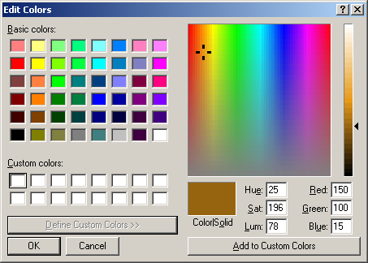
Try
This!
Load Paint
Click [Colors] - [Edit Colors] - [Define Custom Colors]
Click the triangle at the right side of the window
Move the crosshairs and triangle until you get the color you want in the Color/Solid box.
Copy the Red, Green, and Blue numbers into your java program.
Ignore the Hue, Sat, and Lum!

Slide 47
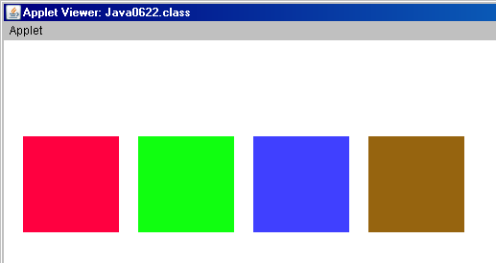
// Java0622.java
// Try This! Add your customized color!
public class Java0622 extends Applet
{
public void paint(Graphics g)
{
Color myRed = new Color(255,0,64);
Color myGreen = new Color(16,255,16);
Color myBlue = new Color(64,64,255);
Color myBrown = new Color(150,100,15);
g.setColor(myRed);
g.fillRect(20,100,100,100);
g.setColor(myGreen);
g.fillRect(140,100,100,100);
g.setColor(myBlue);
g.fillRect(260,100,100,100);
g.setColor(myBrown);
g.fillRect(380,100,100,100);
}
}
These are the EXACT same color!

Slide 48


Drawing Polygons
Java has some special features to draw polygons.
The Graphics class provides two methods, drawPolygon and fillPolygon.
Before you draw any polygon, you must first create an object of the Polygon class.
The Polygon class has an addPoint method.
The secret in drawing polygons is to use the following three steps:
1. Construct a Polygon object
2. Add coordinates to the object using addPoint
3. Draw the Polygon with drawPolygon

Slide 49
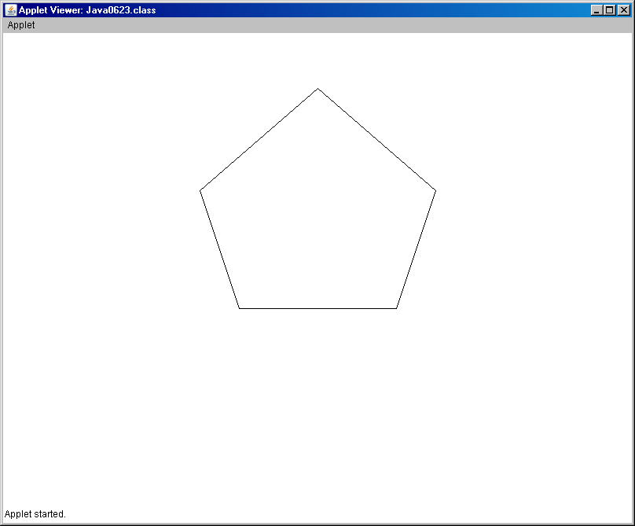
// Java0623.java
// This program draws a pentagon with the <drawPolygon> method.
// Methods <drawPolygon> and <fillPolygon> take a Polygon object as
// parameter. The polygon object stores a set of points. Points can
// be added to a Polygon object with the <addPoint> method.
import java.awt.*;
import java.applet.*;
public class Java0623 extends Applet
{
public void paint(Graphics g)
{
Polygon penta = new Polygon();
penta.addPoint(400,70);
penta.addPoint(550,200);
penta.addPoint(500,350);
penta.addPoint(300,350);
penta.addPoint(250,200);
g.drawPolygon(penta);
}
}
Try this!
Change
drawPolygon
to
fillPolygon

Slide 50
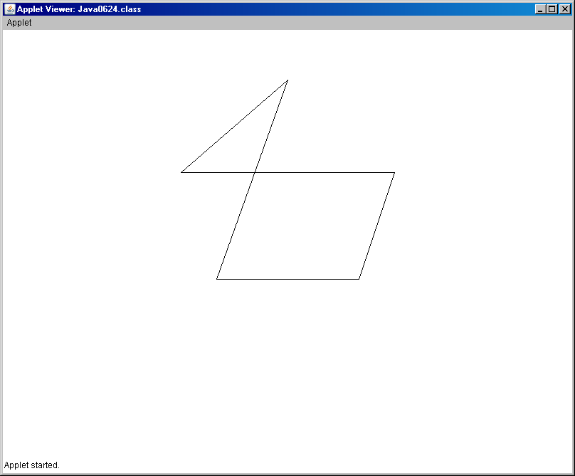
// Java0624.java
// This program demonstrates that the sequence of adding points is
// significant. The same coordinates of the previous program are used
// in the different sequence. The display is very different.
import java.awt.*;
import java.applet.*;
public class Java0624 extends Applet
{
public void paint(Graphics g)
{
Polygon penta = new Polygon();
penta.addPoint(300,350);
penta.addPoint(400,70);
penta.addPoint(250,200);
penta.addPoint(550,200);
penta.addPoint(500,350);
g.drawPolygon(penta);
}
}

Slide 51
Section 6.8
Random Numbers &
Graphics Objects

Slide 52
// Java0625.java
// This program displays 1000 random lines.
import java.awt.*;
import java.applet.*;
import java.util.Random;
public class Java0625 extends Applet
{
public void paint(Graphics g)
{
Random rndInt = new Random(12345);
for (int k = 1; k <= 1000; k++)
{
int x1 = rndInt.nextInt(800);
int y1 = rndInt.nextInt(600);
int x2 = rndInt.nextInt(800);
int y2 = rndInt.nextInt(600);
g.drawLine(x1,y1,x2,y2);
}
}
}
Output on the
next slide.

Slide 53
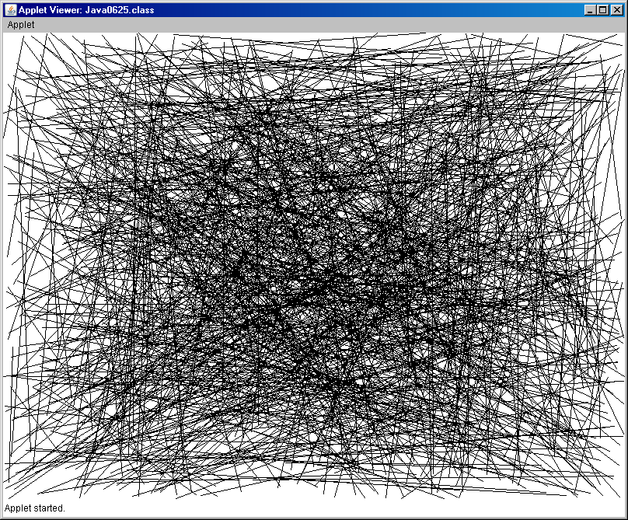

Slide 54
// Java0626.java
// This program combines random squares with random color objects.
import java.awt.*;
import java.applet.*;
import java.util.Random;
public class Java0626 extends Applet
{
public void paint(Graphics g)
{
Random rndInt = new Random(12345);
for (int k = 1; k <= 1000; k++)
{
int x = rndInt.nextInt(800);
int y = rndInt.nextInt(600);
int red = rndInt.nextInt(256);
int green = rndInt.nextInt(256);
int blue = rndInt.nextInt(256);
g.setColor(new Color(red,green,blue));
g.fillRect(x,y,50,50);
}
}
}
Output on the
next slide.

Slide 55
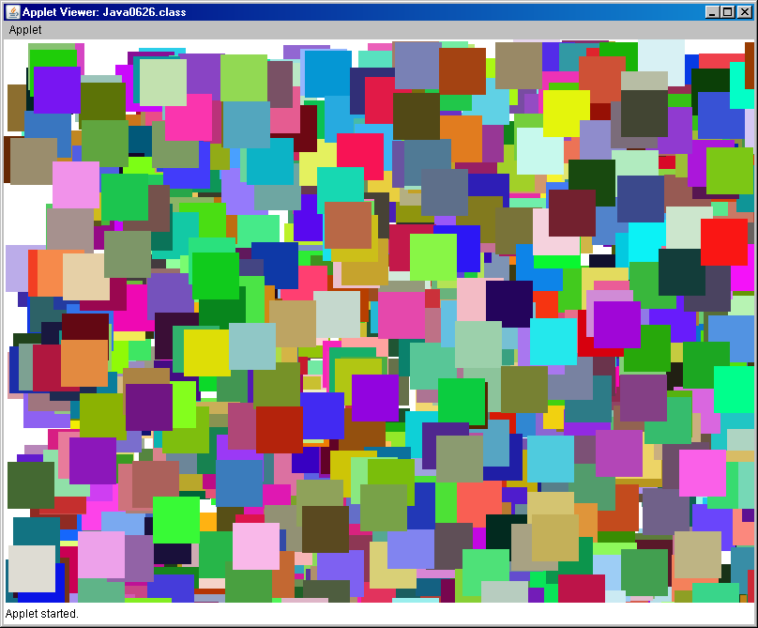

Slide 56
Section 6.9
Using the
Scanner
class

Slide 57
Java 5.0 Alert
The Scanner class is a feature that is released with the JDK 5.0 (Java Development Kit) by Sun Micro Systems.
The Scanner class will not be recognized by any earlier editions of the Java language.

Slide 58
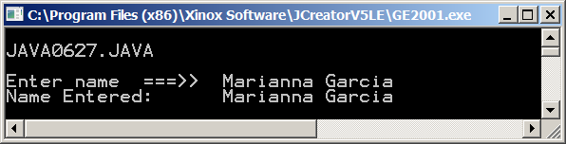
// Java0627.java
// This demonstrates how to instantiate a <Scanner> object.
// The <input> object is used with the <nextLine> method to enter
// string values from the keyboard.
import java.util.Scanner;
public class Java0627
{
public static void main (String args[])
{
Scanner input = new Scanner(System.in);
System.out.println("\nJAVA0627.JAVA\n");
System.out.print("Enter name ===>> ");
String name = input.nextLine();
System.out.println("Name Entered: " + name);
System.out.println();
}
}

Slide 59
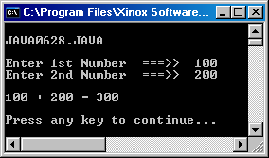
// Java0628.java
// This program uses the <nextInt> method to enter integers from the
// keyboard.
// The arithmetic addition proves that the entered values are integers.
import java.util.Scanner;
public class Java0628
{
public static void main (String args[])
{
System.out.println("\nJAVA0628.JAVA\n");
Scanner input = new Scanner(System.in);
System.out.print("Enter 1st Number ===>> ");
int number1 = input.nextInt();
System.out.print("Enter 2nd Number ===>> ");
int number2 = input.nextInt();
int sum = number1 + number2;
System.out.println();
System.out.println(number1 + " + " + number2 + " = " + sum);
System.out.println();
}
}

Slide 60
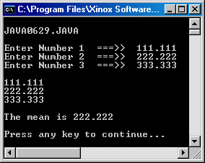
// Java0629.java
// This program demonstrates how to use the <nextDouble> method for three separate
// double keyboard inputs, which are used to display the mean.
import java.util.Scanner;
public class Java0629
{
public static void main (String args[])
{
System.out.println("\nJAVA0629.JAVA\n");
Scanner input = new Scanner(System.in);
System.out.print("Enter Number 1 ===>> ");
double n1 = input.nextDouble();
System.out.print("Enter Number 2 ===>> ");
double n2 = input.nextDouble();
System.out.print("Enter Number 3 ===>> ");
double n3 = input.nextDouble();
System.out.println();
System.out.println(n1);
System.out.println(n2);
System.out.println(n3);
double mean = (n1+n2+n3)/3;
System.out.println();
System.out.println("The mean is " + mean);
System.out.println();
}
}

Slide 61
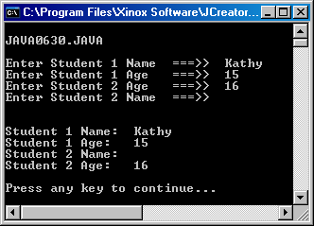
// Java0630.java
// This program demonstrates an interesting problem with the <Scanner> class.
// It appears that order matters. Enter a string first, followed by a number, and
// everything is fine. In reverse order there is no opportunity to enter a name.
import java.util.Scanner;
public class Java0630
{
public static void main (String args[])
{
System.out.println("\nJAVA0630.JAVA\n");
Scanner input = new Scanner(System.in);
System.out.print("Enter Student 1 Name ===>> ");
String name1 = input.nextLine();
System.out.print("Enter Student 1 Age ===>> ");
int age1 = input.nextInt();
System.out.print("Enter Student 2 Age ===>> ");
int age2 = input.nextInt();
System.out.print("Enter Student 2 Name ===>> ");
String name2 = input.nextLine();
System.out.println("\n\n");
System.out.println("Student 1 Name: " + name1);
System.out.println("Student 1 Age: " + age1);
System.out.println("Student 2 Name: " + name2);
System.out.println("Student 2 Age: " + age2);
System.out.println();
}
}

Slide 62
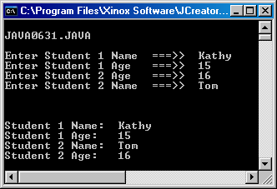
// Java0631.java
// This program cures the <Scanner> class problem with a "dummy" variable.
// The dummy variable removes the <crLf> character from the buffer.
import java.util.Scanner;
public class Java0631
{
public static void main (String args[])
{
System.out.println("\nJAVA0631.JAVA\n");
Scanner input = new Scanner(System.in);
System.out.print("Enter Student 1 Name ===>> ");
String name1 = input.nextLine();
System.out.print("Enter Student 1 Age ===>> "); int age1 = input.nextInt();
System.out.print("Enter Student 2 Age ===>> ");
int age2 = input.nextInt();
String dummy = input.nextLine();
System.out.print("Enter Student 2 Name ===>> ");
String name2 = input.nextLine();
System.out.println("\n\n");
System.out.println("Student 1 Name: " + name1);
System.out.println("Student 1 Age: " + age1);
System.out.println("Student 2 Name: " + name2);
System.out.println("Student 2 Age: " + age2);
System.out.println();
}
}
removes
CRLF

Slide 63
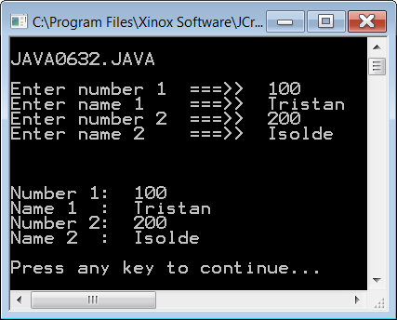
// Java0632.java
// This program example shows a second solution to the buffer problem.
// In this case two <Scanner> objects are constructed for <int> input and
// <String> input. It is not necessary to clear the buffer with a "dummy" variable.
import java.util.Scanner;
public class Java0632
{
public static void main (String args[])
{
System.out.println("\nJAVA0632.JAVA\n");
Scanner intInput = new Scanner(System.in);
Scanner stringInput = new Scanner(System.in);
System.out.print("Enter number 1 ===>> ");
int number1 = intInput.nextInt();
System.out.print("Enter name 1 ===>> ");
String name1 = stringInput.nextLine();
System.out.print("Enter number 2 ===>> ");
int number2 = intInput.nextInt();
System.out.print("Enter name 2 ===>> ");
String name2 = stringInput.nextLine();
System.out.println("\n\n");
System.out.println("Number 1: " + number1);
System.out.println("Name 1 : " + name1);
System.out.println("Number 2: " + number2);
System.out.println("Name 2 : " + name2);
System.out.println();
}
}

Slide 64
Scanner class Notes
With the release of Java JDK 5.0 the Scanner class is available for interactive, text-style, program input.
The Scanner class is part of the util package.
Keyboard input requires a Scanner object that is instantiated with the System.in parameter, like:
Scanner keyboard = new Scanner(System.in)
The nextLine() method is used to enter String information.
The nextInt() method is used to enter int information.
The nextDouble() method is used to enter double information.
Methods nextInt and nextDouble do not remove the CRLF character from the buffer, like the nextLine method.
This means that a dummy String variable must be used like:
String dummy = input.nextLine();
There also exists an alternative solution. Create 2 Scanner objects:
One for number input and one for text input.

Slide 65
AP Exam Alert
Keyboard input is extremely important
for efficient program testing that avoids
hard-coding variable values.
However, the Scanner class is not tested
on the AP Computer Science Examination.

Slide 66
Section 6.10
Using the
Integer
class

Slide 67
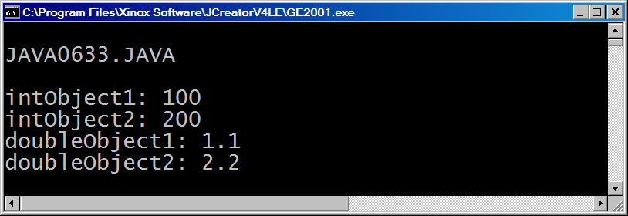
// Java0633.java
// This program introduces the <Integer> class.
// An <Integer> object is an "object" which can store an <int> value.
// The <Integer> class is used in this program as it was required
// in the Java versions before Java 5.0.
// This is also the manner in which AP Exam questions will appear.
import java.util.Scanner;
public class Java0633
{
public static void main (String args[])
{
System.out.println("\nJAVA0633.JAVA\n");
Integer intObject1 = new Integer(100);
Integer intObject2 = new Integer(200);
Double doubleObject1 = new Double(1.1);
Double doubleObject2 = new Double(2.2);
System.out.println("intObject1: " + intObject1.intValue());
System.out.println("intObject2: " + intObject2.intValue());
System.out.println("doubleObject1: " + doubleObject1.doubleValue());
System.out.println("doubleObject2: " + doubleObject2.doubleValue());
System.out.println();
}
}

Slide 68
int vs. Integer double vs. Double
int and double are simple/primitive data types.
Integer and Double (capital “D”) are classes.
These classes have attributes and methods.
int and double should be used for mathematical calculations.
Integer and Double should be used when objects,
not simple/primitive data types, are required.
You will see examples of this later in the course.

Slide 69
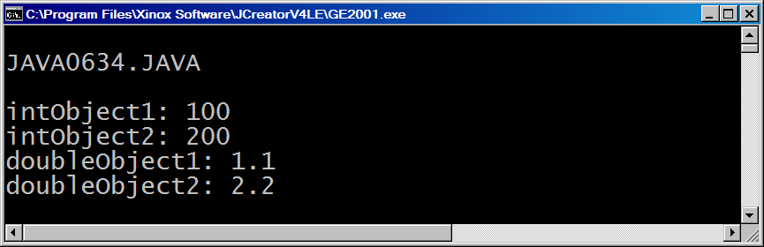
// Java0634.java
// This program demonstrates the exact same processing as the
// previous program. This processing is accomplished with less
// program code. These shortcut features came available with
// Java version 5.0 and later versions.
import java.util.Scanner;
public class Java0634
{
public static void main (String args[])
{
System.out.println("\nJAVA0634.JAVA\n");
Integer intObject1 = 100;
Integer intObject2 = 200;
Double doubleObject1 = 1.1;
Double doubleObject2 = 2.2;
System.out.println("intObject1: " + intObject1);
System.out.println("intObject2: " + intObject2);
System.out.println("doubleObject1: " + doubleObject1);
System.out.println("doubleObject2: " + doubleObject2);
System.out.println();
}
}

Slide 70
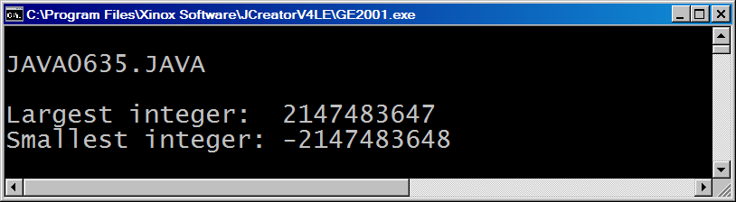
// Java0635.java
// <int> values are stored in four bytes.
// This program uses the <Integer.MAX_VALUE> and <Integer.MIN_VALUE>
// constants to display the largest and smallest <int> values.
import java.util.Scanner;
public class Java0635
{
public static void main (String args[])
{
System.out.println("\nJAVA0635.JAVA\n");
System.out.println("Largest integer: " + Integer.MAX_VALUE);
System.out.println("Smallest integer: " + Integer.MIN_VALUE);
System.out.println();
}
}

